Slide 1

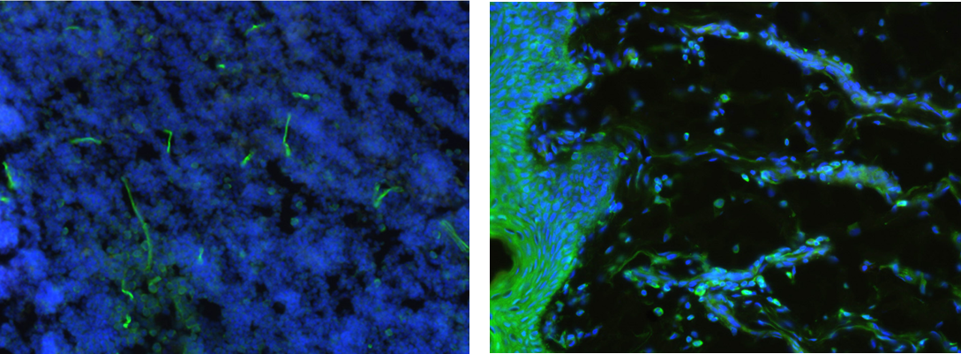
ReliaTech GmbH
Rabbit anti-human CXCR4
(Cat #102-PA120AG)
Immunofluorescence staining (green) of cryo-sections of human lung tissue and forskin (fixed 15 min in 4% PFA) with anti-human CXCR4 (5µg/ml) [Cat# 103-PA120AG] and counter staining of nuclei with Dapi. Specimen provided by Prof. Dr. J. Wilting, Goettingen.
The experiment was performed by the research group of Prof. Dr. J. Wilting and Dr. K. Buttler, University Göttingen, Germany.
http://www.reliatech.de / orders@reliatech.de

